Slide 1

Understanding Vector Databases
20097 – Zeynep Salihoglu

Slide 2
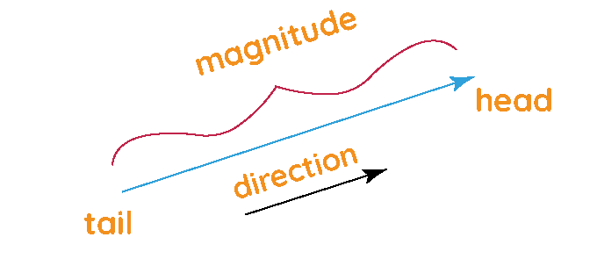
What is a vector?
Vectors in AI and Machine Learning
In AI, vectors are used to represent data points in multi-dimensional space, not physical quantities.
Vectors are lists of numbers that describe an object's features.
No physical direction or magnitude; instead, they capture relationships and similarities in data.
A vector is a quantity that has both magnitude (size) and direction.
Written as (x, y) in 2D or (x, y, z) in 3D.
Often visualized as an arrow in space, where:
Length = Magnitude
Arrowhead = Direction

Slide 3
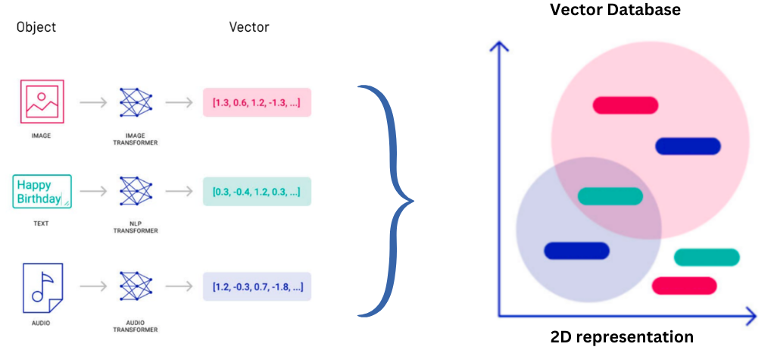
Examples:
Text: Sentences can be represented as vectors using embedding models like BERT or Word2Vec.
Images: Pixels or features extracted by a neural network are stored as vectors.
Audio: Frequencies and time-series data are represented as vectors.

Slide 4
What is a Vector Database?
A vector database is a collection of data stored as mathematical representations.
Optimized to store, index, and query vectorized data, representing the semantic meaning of unstructured data (e.g., text, images, audio).
Data is identified using similarity metrics instead of exact matches, enabling contextual understanding of data.

Slide 5
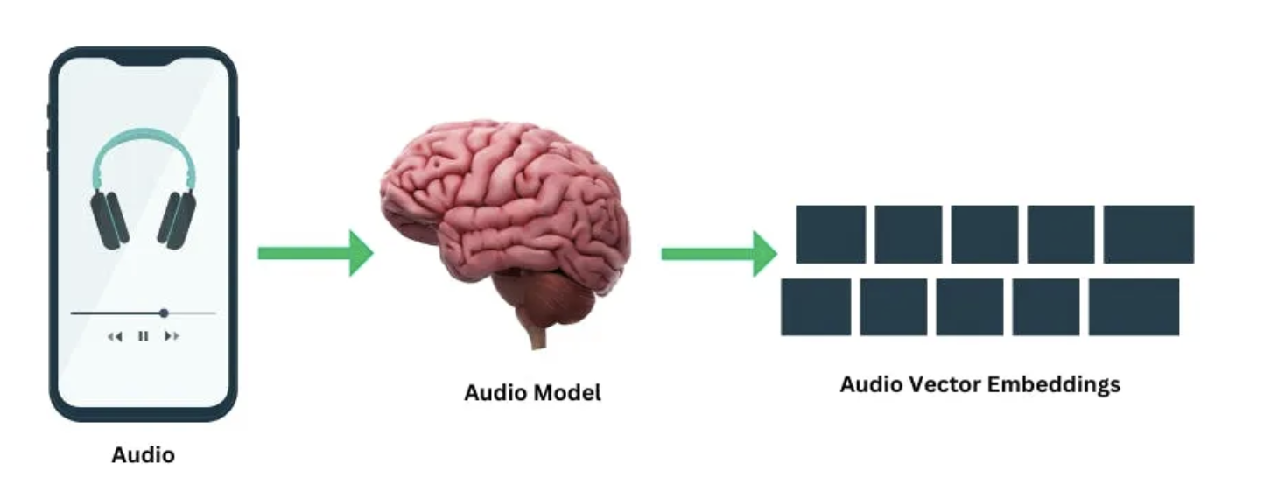
How Do Vector Databases Store Data?

Slide 6
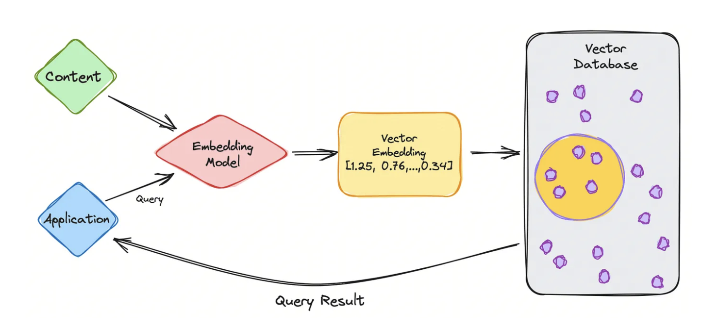
How Do Vector Databases Work?

Slide 7

What is vector embeddings? Vector embeddings are a way to convert words and sentences and other data into numbers that capture their meaning and relationships.

Slide 8
Why use a Vector Database?
Allows machine learning models to "remember" previous inputs and learn from context.
Key Applications:
Search: Power semantic and contextual searches.
Recommendations: Provide personalized suggestions.
Text Generation: Enhance generative AI use cases.
Significance:
Enables systems to work with unstructured data effectively by understanding the context of data.

Slide 9
Traditional Databases vs. Vector Databases
FEATURE | TRADITIONAL DATABASE | VECTOR DATABASE
DATA REPRESENTATION | Rows and columns | High-dimensional vectors
SEARCH MECHANISM | Exact matches | Similarity search
DATA TYPES | structured | unstructured
TECHNOLOGY | SQL | Embedding models like Word2Vec, BERT

Slide 10
Advantages of Vector Databases
Speed and performance: Vector databases use advanced indexing techniques, such as nearest neighbor search, to enable fast and efficient querying, even with large datasets.
Scalability: They can handle massive datasets by scaling horizontally, allowing for efficient management of increasing data volumes and query demands.
Lower cost of ownership: By enabling faster data retrieval and model training, vector databases reduce computational costs, improving the efficiency of machine learning processes.
Data management: Vector databases provide built-in features for seamlessly updating and inserting new unstructured data, simplifying data management tasks.
Flexibility: They can store and manage various types of unstructured data (text, images, audio), making them highly adaptable for different AI and machine learning applications.

Slide 11
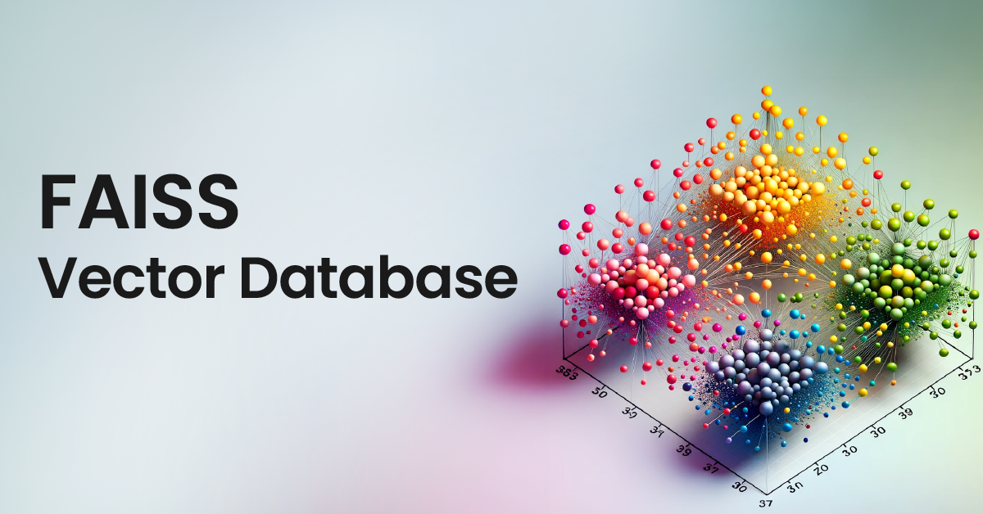
FAISS (Facebook AI Similarity Search) -Vector Database
This library allows us to quickly search for multimedia documents that are similar to each other, and it acts like a Vector Database.

Slide 12


Slide 13
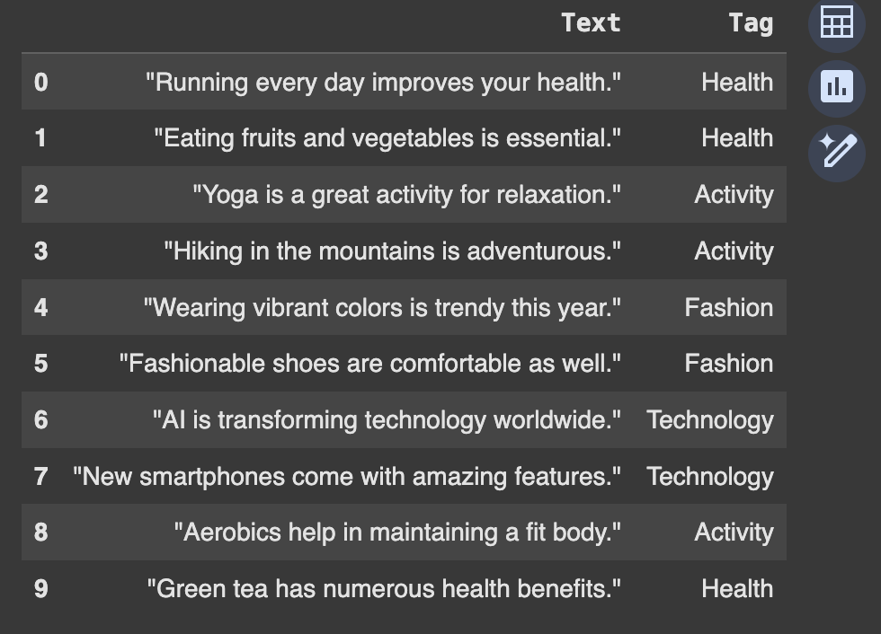
!pip install faiss-cpu !pip install sentence-transformers import pandas as pd df = pd.read_csv('/content/Tag.csv') df

Slide 14
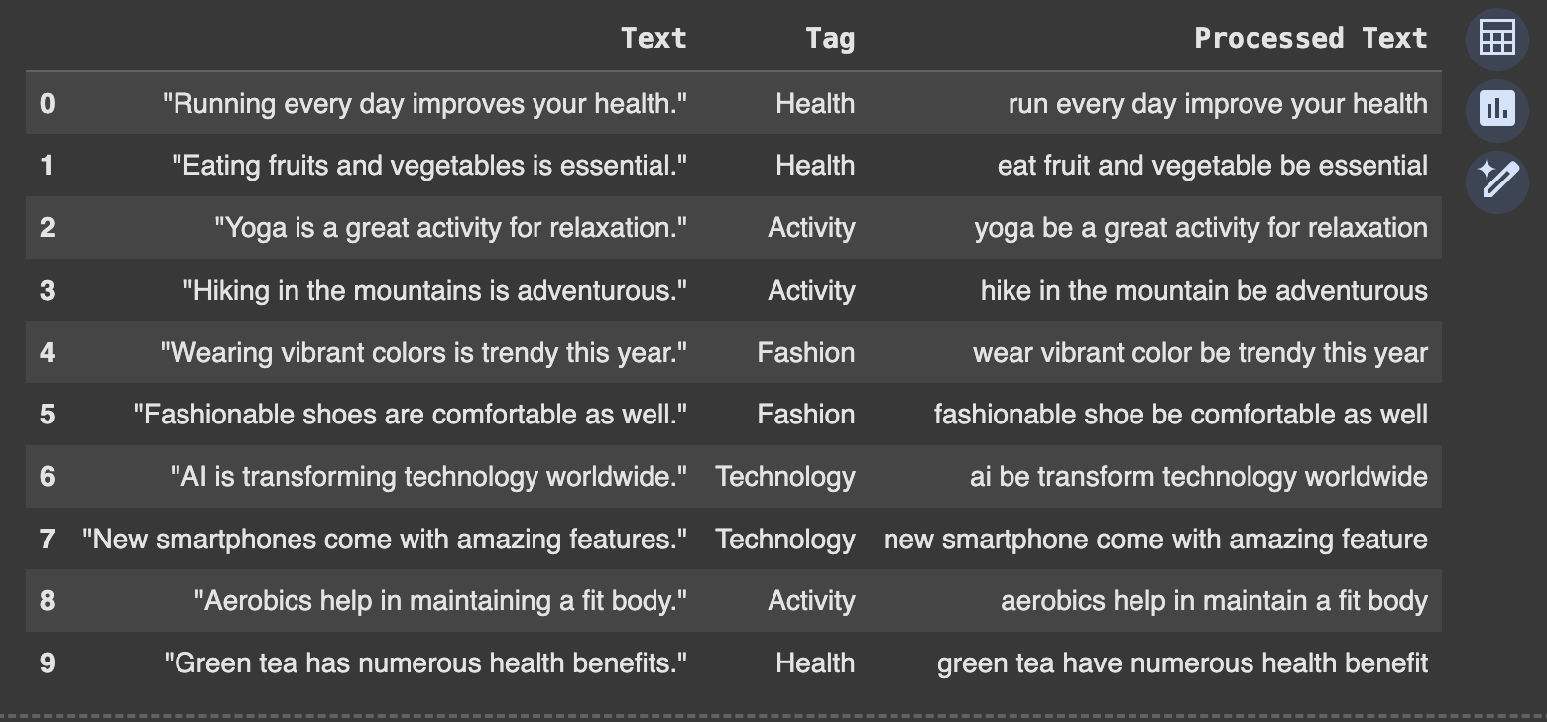
import spacy nlp = spacy.load('en_core_web_sm') stop_words = nlp.Defaults.stop_words def preprocess(text): doc = nlp(str(text)) preprocessed_text = [] for token in doc: if token.is_punct or token.like_num or token in stop_words or token.is_space: continue preprocessed_text.append(token.lemma_.lower().strip()) return ' '.join(preprocessed_text) df['Processed Text'] = df['Text'].apply(preprocess) df

Slide 15
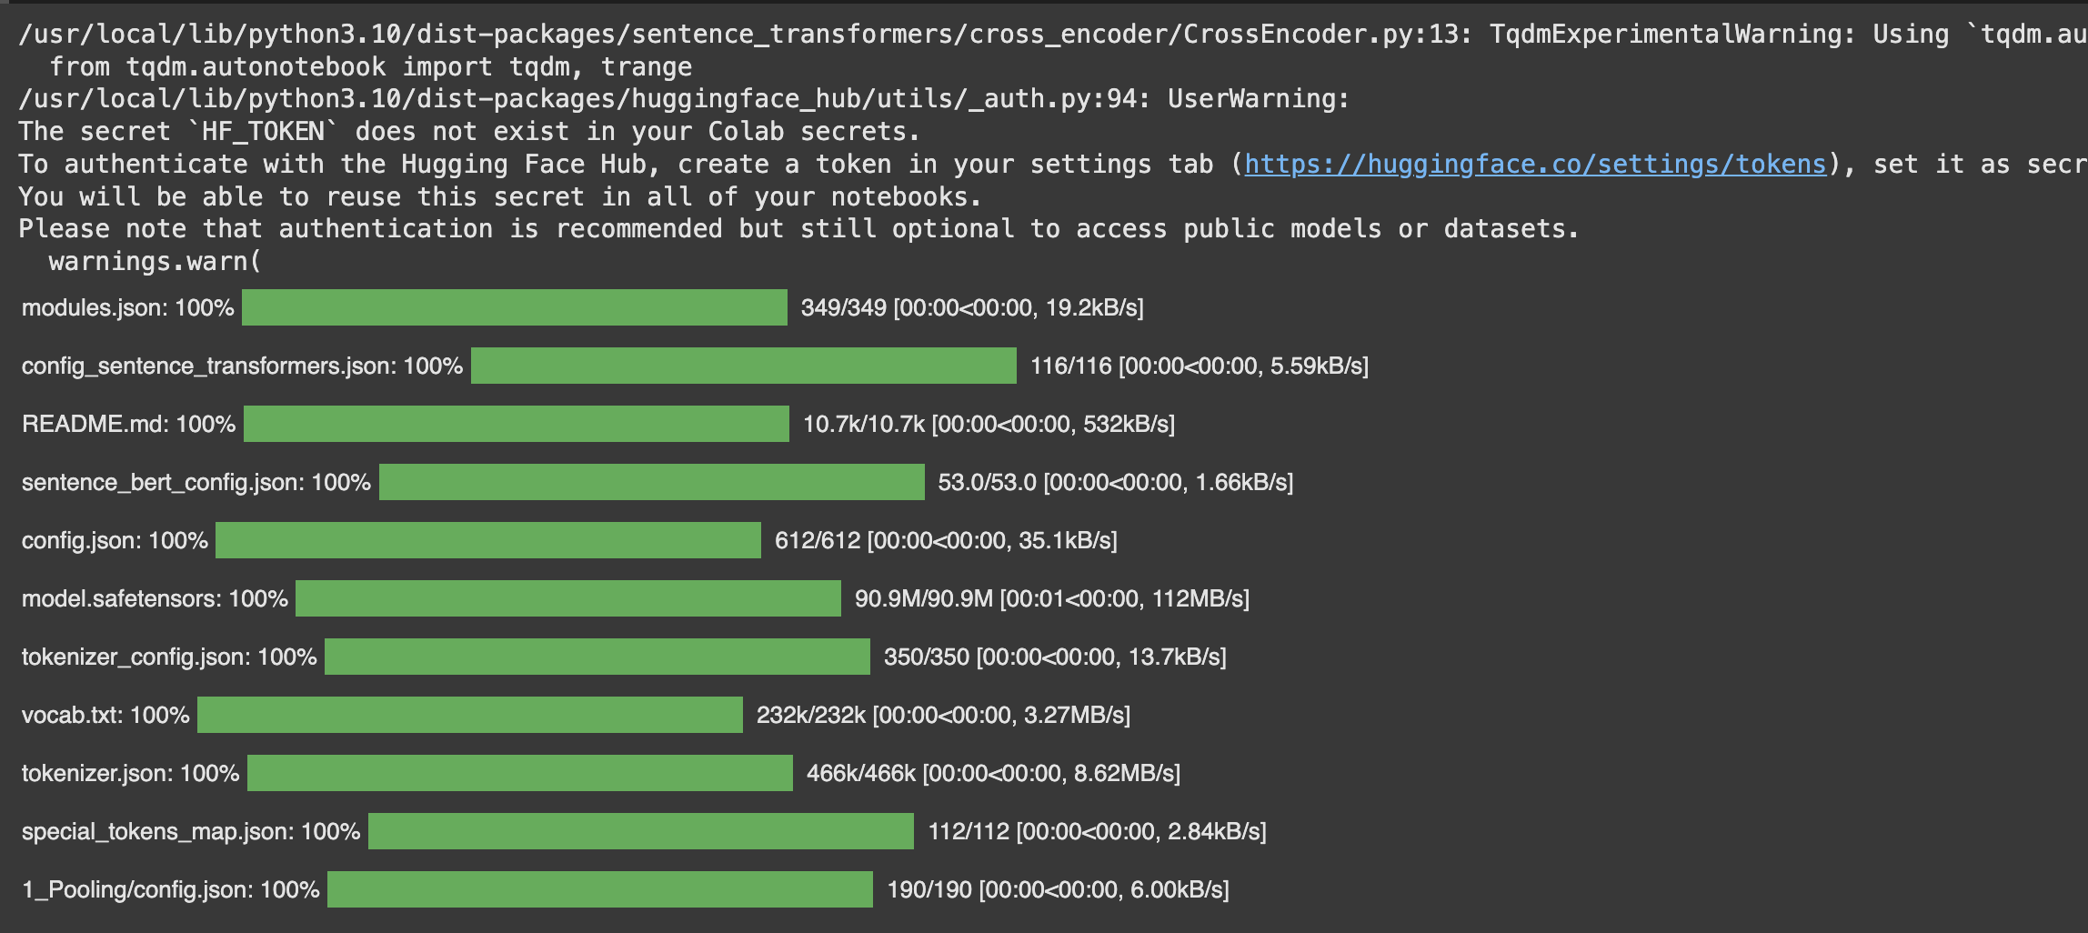
from sentence_transformers import SentenceTransformer model = SentenceTransformer('all-MiniLM-L6-v2') df['Embedding'] = df['Processed Text'].apply(model.encode) vector = model.encode(df['Processed Text'])

Slide 16
dim = vector.shape[1] import faiss index = faiss.IndexFlatL2(dim) index.add(vector) search_query = 'I like eating cauliflower' test_pre = preprocess(search_query) encode_pre = model.encode(test_pre) encode_pre.shape #FAISS expects 2d array, so next step we are converting encode_pre to a 2D array import numpy as np svec = np.array(encode_pre).reshape(1,-1) #We will get euclidean distance and index of the 2 nearest neighbours distance,pos = index.search(svec,k=2)

Slide 17

df.Text.iloc[pos[0]]

Slide 18
REFERENCES
https://www.cloudflare.com/learning/ai/what-is-vector-database/
https://www.ibm.com/topics/vector-database
https://medium.com/data-and-beyond/vector-databases-a-beginners-guide-b050cbbe9ca0
https://www.elastic.co/what-is/vector-embedding
https://medium.com/@ypredofficial/faiss-vector-database-be3a9725172f

